Slide 1
TOUR GUIDE PROVIDING SERVICE
Presented By:
Tanmoy Mazumder(19101013)
Ali Mostakim Alvi(19101015)
Shawan Das(19101020)
Presented TO:
Shammi Akhtar
Assistant Professor
CSE, UAP

Slide 2
Contents
Methodology
In context to this project
Rules of Use Case Diagram
Use Case Diagram

Slide 3
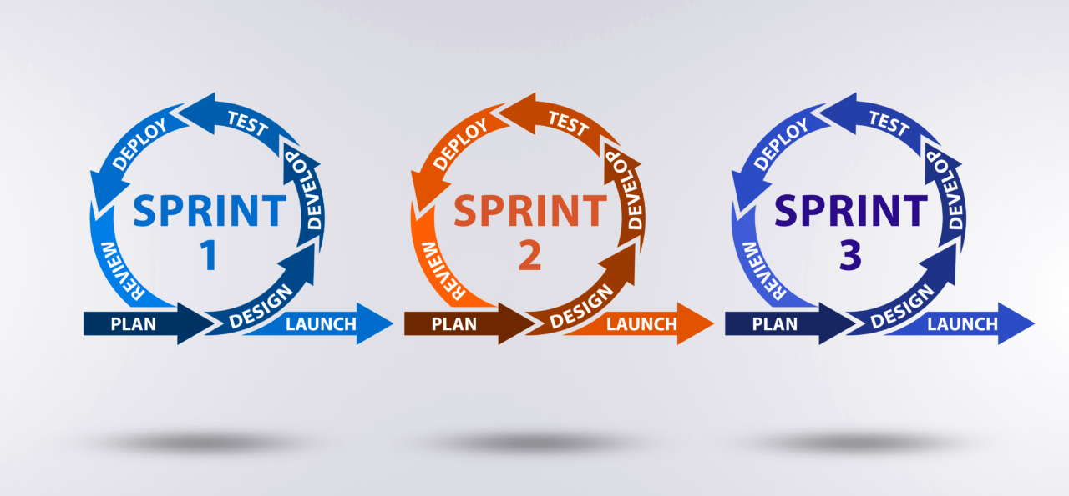
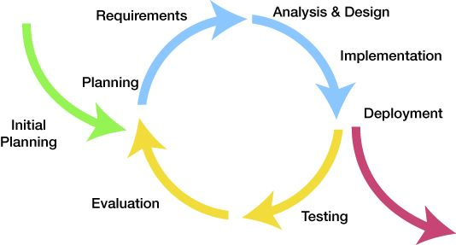
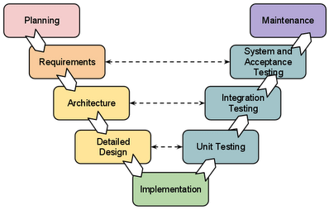
Methodology
V-model Methodology
Iterative Methodology
Agile Methodology

Slide 4
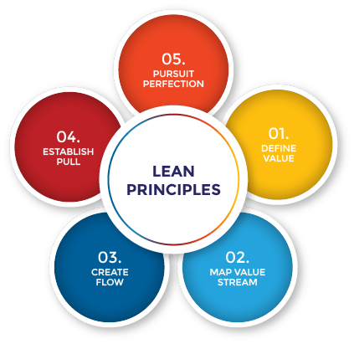
Methodology
V-model Methodology
Iterative Methodology
Agile Methodology
Lean Methodology

Slide 5
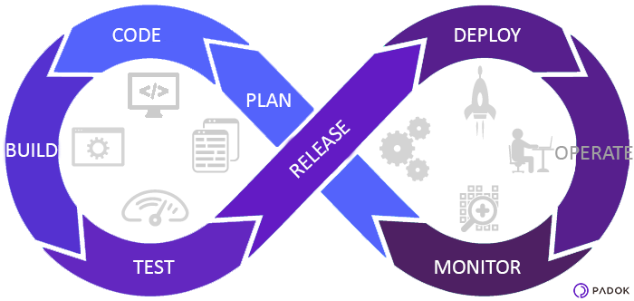
Methodology
V-model Methodology
Iterative Methodology
Agile Methodology
Lean Methodology
DevOps Methodology

Slide 6
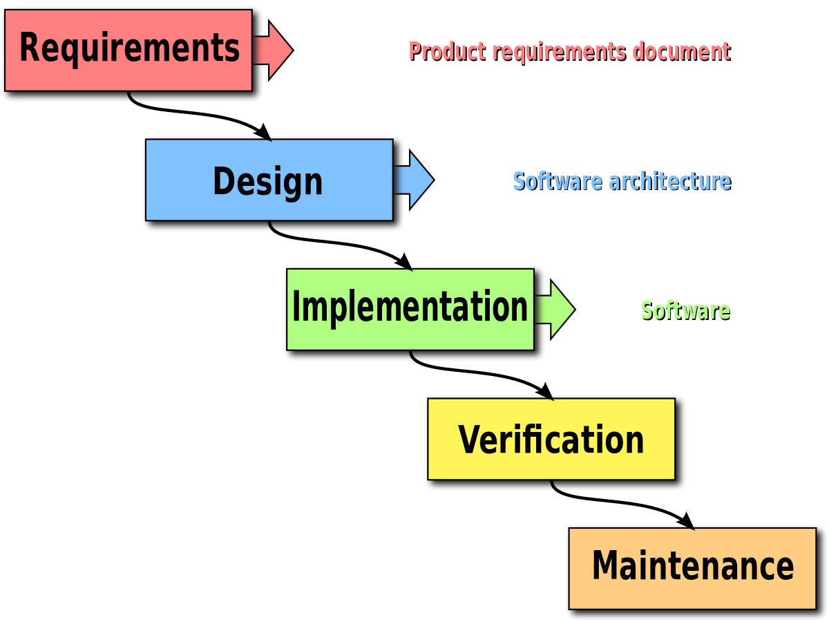
Methodology
V-model Methodology
Iterative Methodology
Agile Methodology
Lean Methodology
DevOps Methodology
Waterfall Methodology

Slide 7


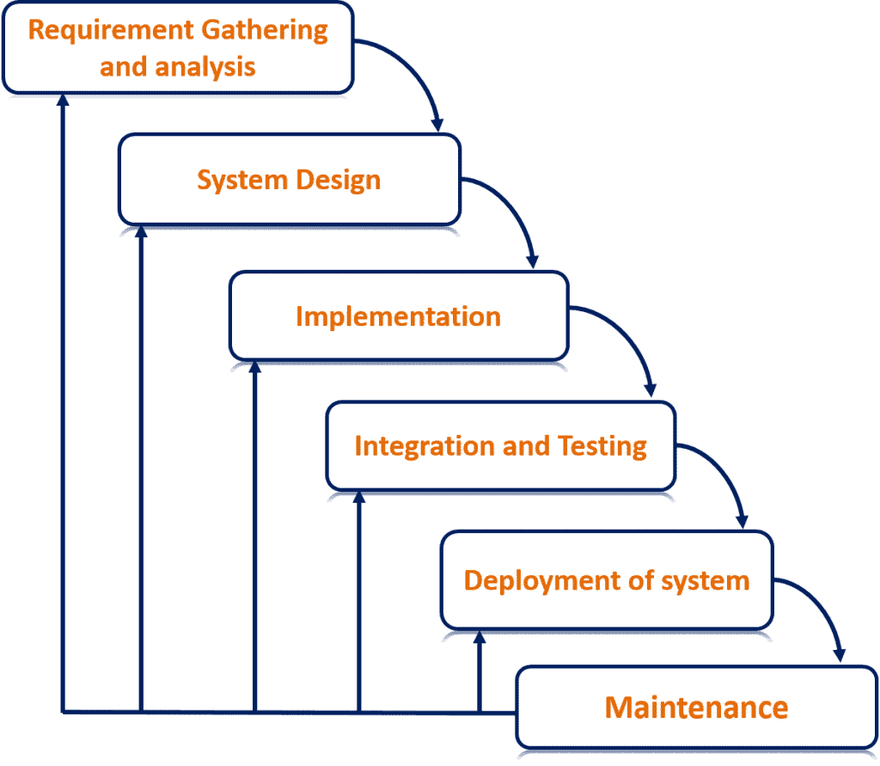


Methodology Used In Our Project

Slide 8
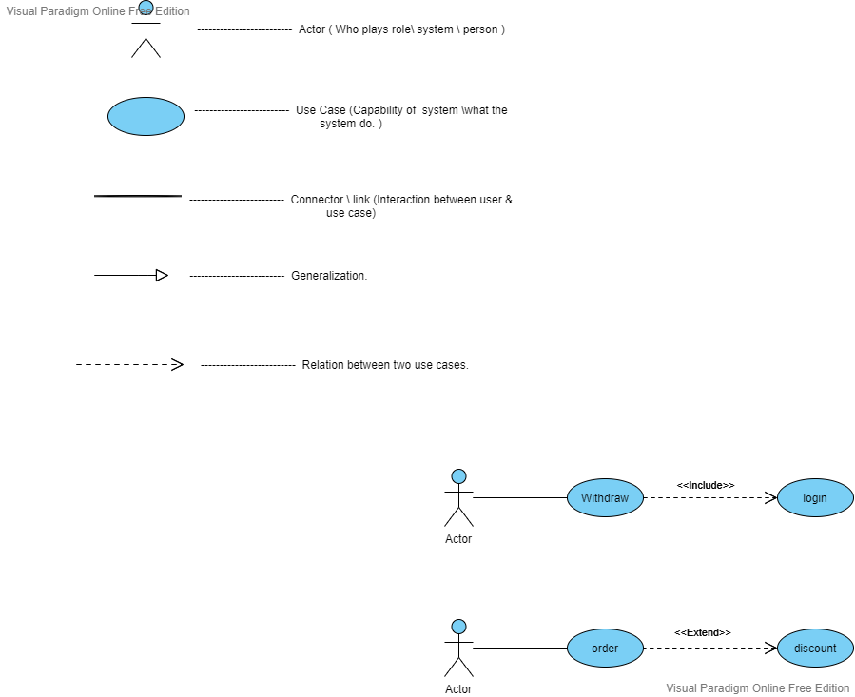
Use case diagram

Slide 10
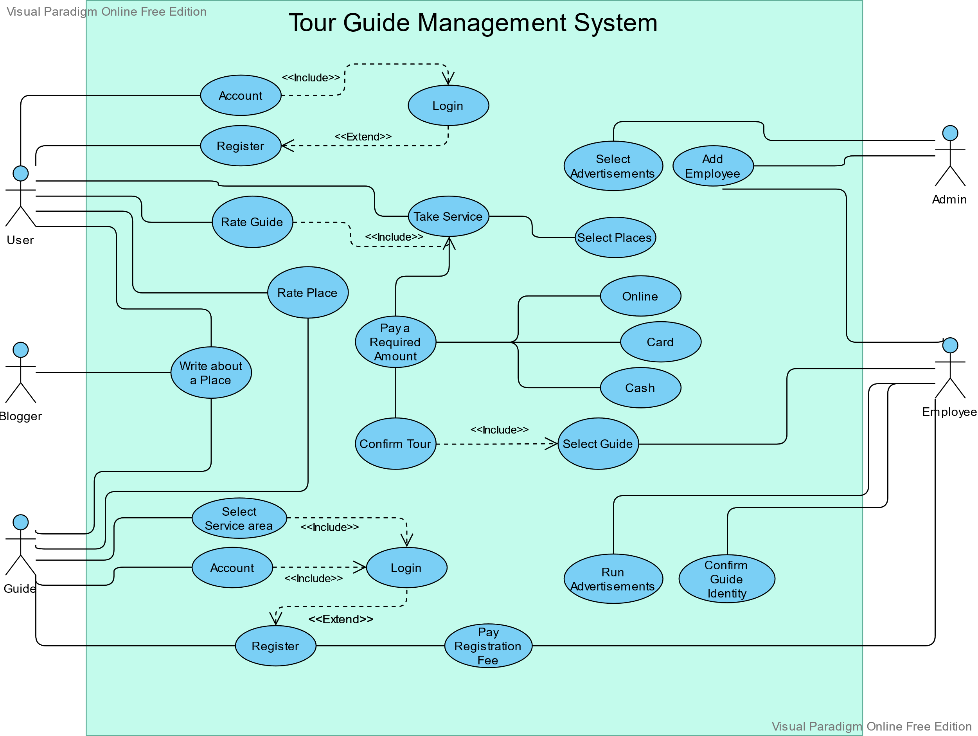

Slide 11
Thank You

